Slide 1
Instructions
Work within your group to answer as many questions as you can, correctly, within the time limit
Referencing from online materials/ lecture notes are not allowed!
Each group will be given a one-time lifeline to ask the teacher a T/F question

Slide 2
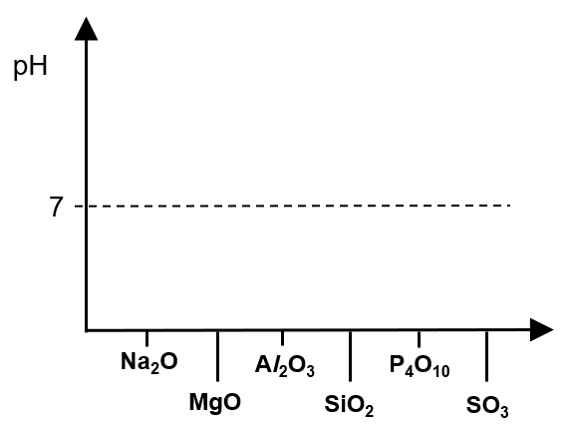
[Q1]
Sketch a graph to show the variation in pH of the resultant mixture formed from Period 3 oxides mixed with water.
Write equations for the reactions (if any) of the oxides: SiO₂, P₄O₁₀, SO₃ with water and state the pH of each resultant mixture.

Slide 3
[Q2]
Write an equation for any reaction that occurs between NaOH (aq) and each oxide: Na₂O, Al₂O₃, P₄O₁₀

Slide 4
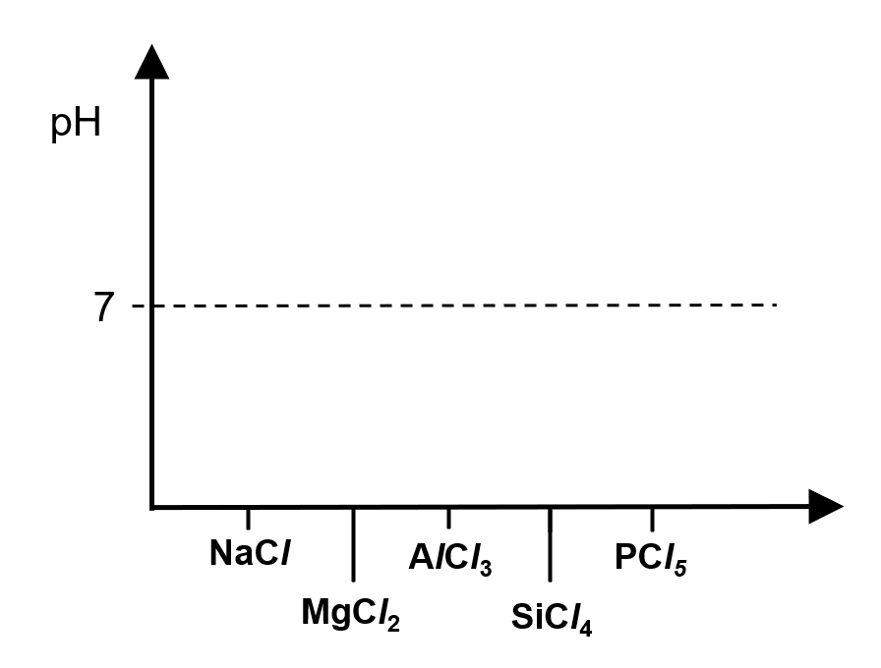
[Q3]
Sketch a graph to show the variation in pH of the resultant mixture formed from Period 3 chlorides mixed with excess water.
State the pH of the resultant mixture when the chlorides:
SiCl₄ and PCl₅ are separately mixed with excess water.
Write equations to explain your answer.

Slide 5
[Q4]
Explain why MgCO₃ decomposes at a lower temperature than BaCO₃
Give two reason to explain why HI decomposes at a lower temperature than HBr

Slide 6
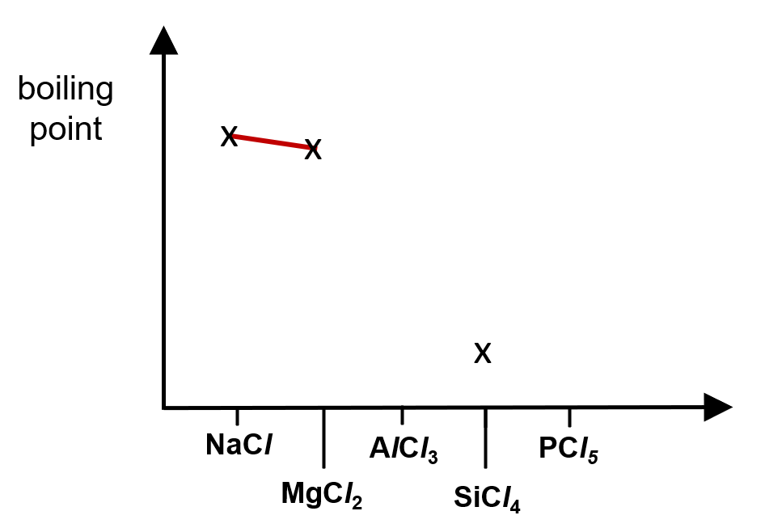
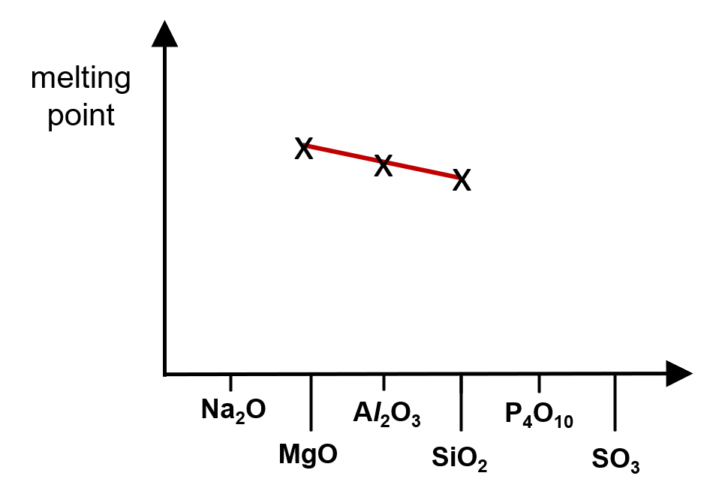
[Q5]
Sketch a graph to show the variation in melting point of the oxides in the third period, from Na to S.
Sketch a graph to show the variation in boiling point of the chlorides in the third period, from Na to P.

